Slide 1
The BigDAWG Polystore System

Slide 2
Database Challenges
Enterprises encounter many databases and data models.
Specialized systems provide performance, but add complexity.

Slide 3

Database Challenges
Enterprises encounter many databases and data models.
Specialized systems provide performance, but add complexity.
BigDAWG goals:
  Provide as much location (database) transparency as possible
  Support a single query notation and interface with limited extensions
BigDAWG

Slide 4
BigDAWG Design
Many “Sizes”
Low Latency
Location Transparency
Support for heterogeneous storage and database engines
Support for real time streaming databases for Internet of things
Allow users to operate on data without explicit knowledge of location
Semantic completeness
Support the widest number of database operations with efficient connectors
Notes:
- OLTP characterized by a large number of short on-line transactions (INSERT, UPDATE, DELETE). The main emphasis for OLTP systems is put on very fast query processing, maintaining data integrity in multi-access environments and an effectiveness measured by number of transactions per second. In OLTP database there is detailed and current data, and schema used to store transactional databases is the entity model (usually 3NF).
- OLAP (On-line Analytical Processing) is characterized by relatively low volume of transactions. Queries are often very complex and involve aggregations. For OLAP systems a response time is an effectiveness measure. OLAP applications are widely used by Data Mining techniques. In OLAP database there is aggregated, historical data, stored in multi-dimensional schemas (usually star schema).

Slide 5
BigDAWG Design
Many “Sizes”
Low Latency
Location Transparency
Support for heterogeneous storage and database engines
Support for real time streaming databases for Internet of things
Allow users to operate on data without explicit knowledge of location
Semantic completeness
Support the widest number of database operations with efficient connectors
Notes:
- OLTP characterized by a large number of short on-line transactions (INSERT, UPDATE, DELETE). The main emphasis for OLTP systems is put on very fast query processing, maintaining data integrity in multi-access environments and an effectiveness measured by number of transactions per second. In OLTP database there is detailed and current data, and schema used to store transactional databases is the entity model (usually 3NF).
- OLAP (On-line Analytical Processing) is characterized by relatively low volume of transactions. Queries are often very complex and involve aggregations. For OLAP systems a response time is an effectiveness measure. OLAP applications are widely used by Data Mining techniques. In OLAP database there is aggregated, historical data, stored in multi-dimensional schemas (usually star schema).

Slide 6
BigDAWG Design
Many “Sizes”
Low Latency
Location Transparency
Support for heterogeneous storage and database engines
Support for real time streaming databases for Internet of things
Allow users to operate on data without explicit knowledge of location
Semantic completeness
Support the widest number of database operations with efficient connectors
Notes:
- OLTP characterized by a large number of short on-line transactions (INSERT, UPDATE, DELETE). The main emphasis for OLTP systems is put on very fast query processing, maintaining data integrity in multi-access environments and an effectiveness measured by number of transactions per second. In OLTP database there is detailed and current data, and schema used to store transactional databases is the entity model (usually 3NF).
- OLAP (On-line Analytical Processing) is characterized by relatively low volume of transactions. Queries are often very complex and involve aggregations. For OLAP systems a response time is an effectiveness measure. OLAP applications are widely used by Data Mining techniques. In OLAP database there is aggregated, historical data, stored in multi-dimensional schemas (usually star schema).

Slide 7
BigDAWG Design
Many “Sizes”
Low Latency
Location Transparency
Support for heterogeneous storage and database engines
Support for real time streaming databases for Internet of things
Allow users to operate on data without explicit knowledge of location
Semantic completeness
Support the widest number of database operations with efficient connectors
Notes:
- OLTP characterized by a large number of short on-line transactions (INSERT, UPDATE, DELETE). The main emphasis for OLTP systems is put on very fast query processing, maintaining data integrity in multi-access environments and an effectiveness measured by number of transactions per second. In OLTP database there is detailed and current data, and schema used to store transactional databases is the entity model (usually 3NF).
- OLAP (On-line Analytical Processing) is characterized by relatively low volume of transactions. Queries are often very complex and involve aggregations. For OLAP systems a response time is an effectiveness measure. OLAP applications are widely used by Data Mining techniques. In OLAP database there is aggregated, historical data, stored in multi-dimensional schemas (usually star schema).

Slide 8
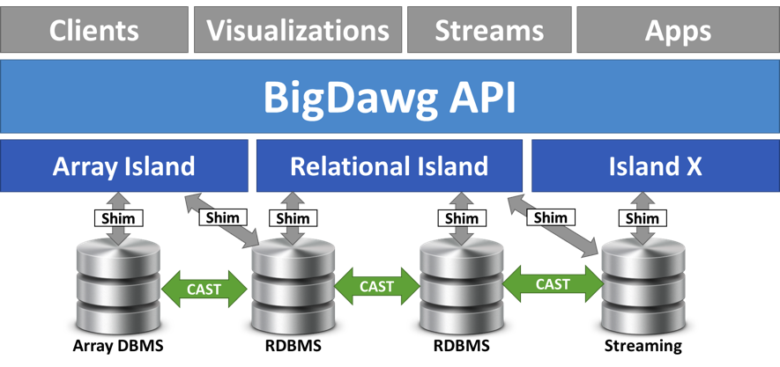
Semantic Islands as the Tradeoff
Islands are the trade-off between functionality and location transparency.
Islands have:
                - A Data Model
                - A Language or Set of Operators
                - A Set of Candidate Database Engines

Slide 9
Semantic Islands as the Tradeoff
Islands are the trade-off between functionality and location transparency.
Islands have:
                - A Data Model
                - A Language or Set of Operators
                - A Set of Candidate Database Engines
User specifies the Island:
RELATIONAL(select avg(temp) from device)
ARRAY(multiply(A,B))

Slide 10
Semantic Islands as the Tradeoff
Islands are the trade-off between functionality and location transparency.
Islands have:
                - A Data Model
                - A Language or Set of Operators
                - A Set of Candidate Database Engines
User specifies the Island:
RELATIONAL(select avg(temp) from device)
ARRAY(multiply(A,B))
Islands do Intersection of engines
BigDAWG does Union of Islands
Islands are logical

Slide 11
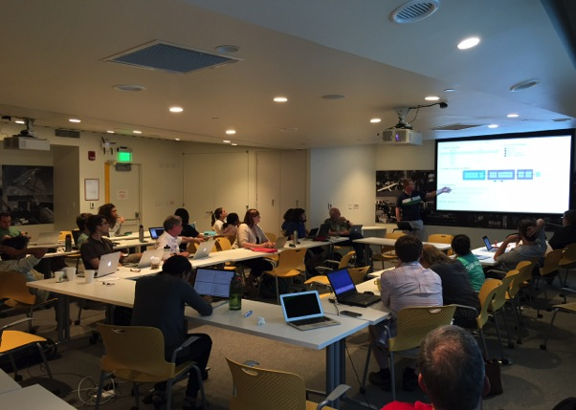








Hackathon to
Prototype BigDAWG
BigDAWG Goal: Harness the power of advanced database engines through a unified interface
BigDAWG is the vision of the ISTC Big Data to develop future technologies and interfaces that support knowledge extraction big data
Recent Hackathon at MIT BeaverWorks produced a BigDAWG prototype

Slide 12
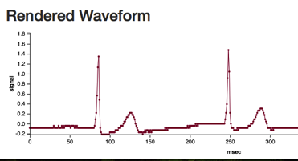
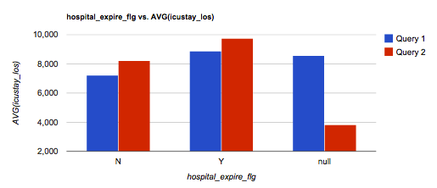

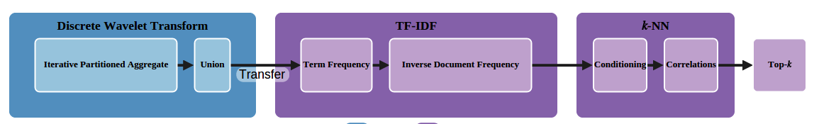
Using BigDAWG Polystore for Medical Big Data
Data Explorer
Tell Me Something Interesting
Text Analytics
Heavy Analytics
Streaming Analytics

Slide 13
Big DAWG Prototype - Island Types
-Text Analytics-
D4M
-Streaming-
S-Store
S-PI
-Tell Something-
SeeDB
Searchlight
-Heavy Analytic-
Myria
-Explorer-
ScalaR
-Watch-
Wearables
S-PI
Client
Big DAWG API
Server
D4M
Associative Arrays
Data Model
Island
(i.e. ARRAY, TEX)
Myria
(Iterative)
Islands
Data Model
Island
(i.e. ARRAY, TEX)
Streams
Data Model
Island
(i.e. ARRAY, TEXT)
Engines
PostgreSQL
SciDB
Accumulo
MyriaX
S-Store
Tabular Clinical
Data
Historical Waveform
Data
Text
Clinical Data
(i.e. chart notes)
Intermediate
results
Streaming
Waveform Data

